Slide 1

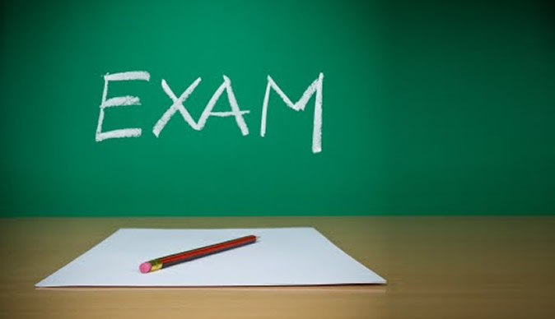
Thornhill Academy Exam Expectations

Slide 2
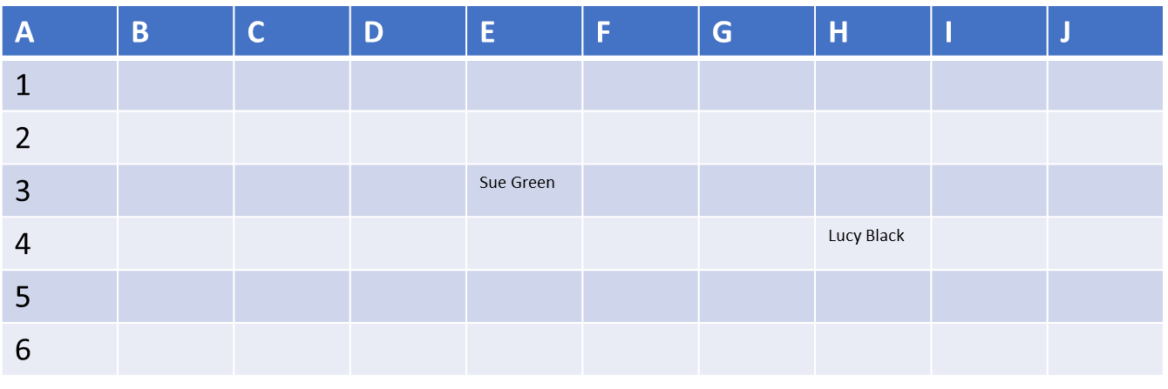
Seating Plans
All Students are to check seating plans, to ensure that they are aware of which room sitting exam and take note of their seat number.
All exams are same desk for each series, and seating plans will be displayed on
the door leading to the Sports Hall, and also in HOY base.
Sports Hall or Alternative Rooms

Slide 3
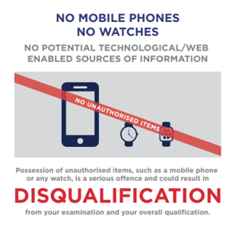
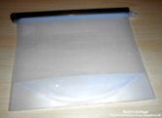
No Mobile Phones/Earbuds/watches etc. are allowed in exams.
These must be switched off and either left in bags/coats or placed into the
plastic wallets provided on desks.
These wallets will have your desk number on, and will be collected at the start of
all exams and returned to you at the end, once exam papers collected.

Slide 4


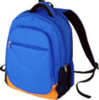

Start Times
All students are to register in the Thumbprint restaurant at 8:40 am for AM exams.
For exams starting during lesson 3 to go straight to relevant room. For lesson 4 or 5 you are to meet in the Thumbprint Restaurant promptly after lunch.
Remember to use the toilet before registration or at start of lunch. You should not require the toilet, during an exam unless you have a toilet pass.
Coates and Bags
• No Outdoor Coats or Bags are allowed and must be left outside of Sports Hall.
In alternative rooms they must be placed either at the front
or back of the room.

Slide 5

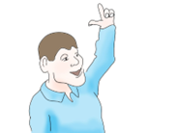
Start of Exam
You must entre exam room quietly and in an orderly manner.
Once you are seated, you must listen carefully to all instructions.
You must check you have the correct exam papers, if you are unsure put your
hand up and ask teacher/invigilator to check.

Slide 6
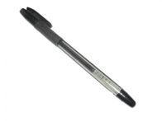
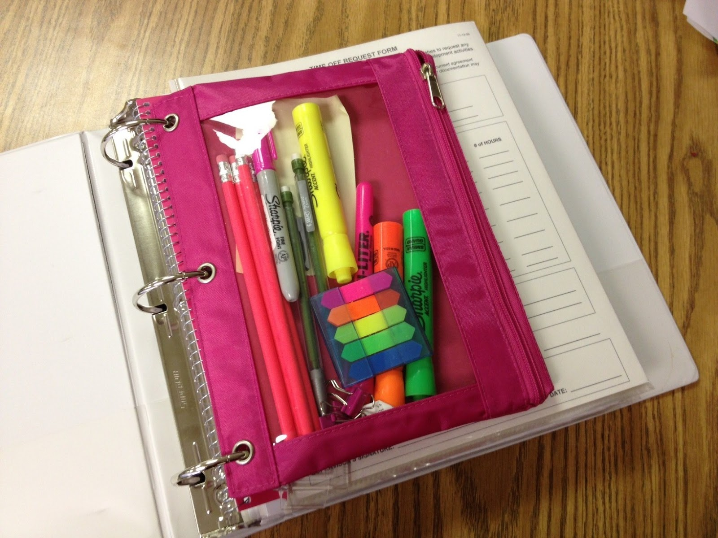
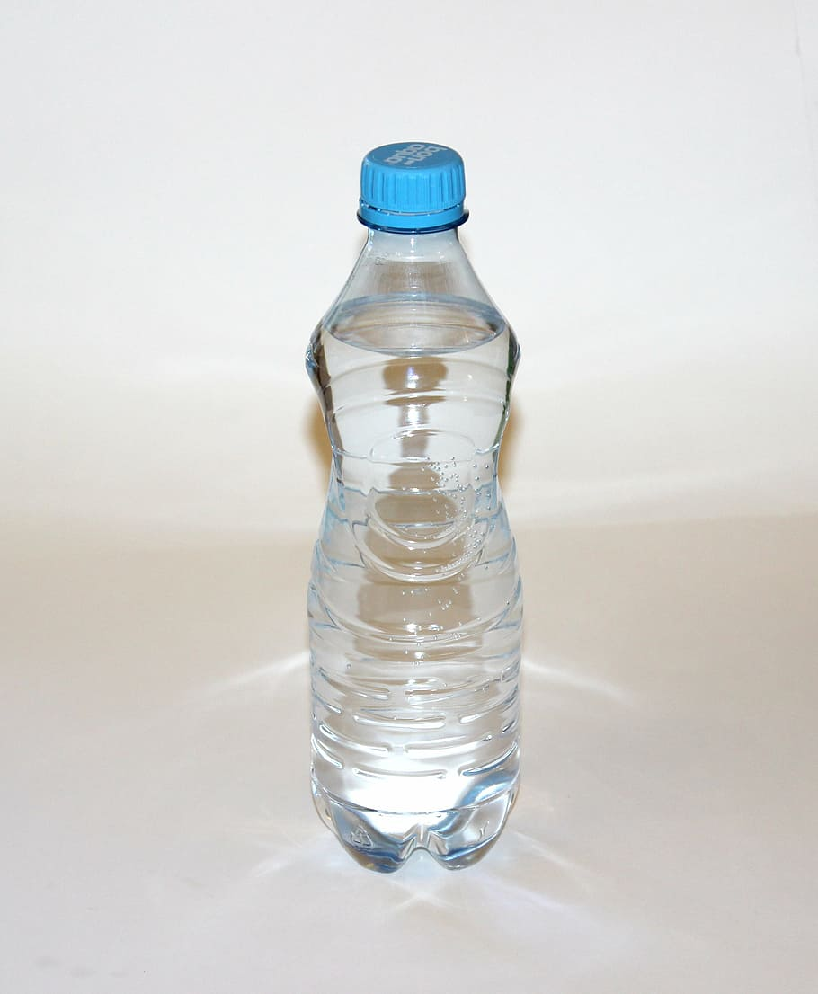
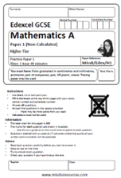
You should come to all exams prepared and with a Black Pen.
There will be a basic stationery pack and calculator on your desk for exams, if you prefer to bring your own it must be in clear/see through case.
Only water should be brought into an exam room, this should be in a clear bottle with labels removed.
Do not open your exam paper until instructed to do so.

Slide 7
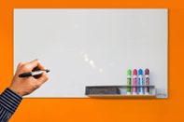

You will be reminded of the duration of the exam and start/finish times will be wrote onto the white board.
When your are instructed to open papers and the exam starts you must not turn around or try to attract attention from other students. You are to complete paper in silence.

Slide 8


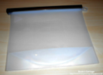
End of Exam
At the end of the exam, you will be asked to remain silent while papers are
collected in.
You will then be given your electronic devices back. Take these out, but DO NOT switch on and leave the plastic wallet
on your desk.
You will then be dismissed row by row, please remember to collect your belongings.

Slide 9
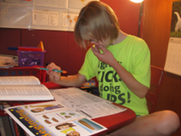

Remember to revise thoroughly and do your very best.

Slide 10


